Slide 1
The Transport Layer
Unit- 6

Slide 2
The Transport Service
Services Provided to the Upper Layers
Transport Service Primitives
Berkeley Sockets

Slide 3
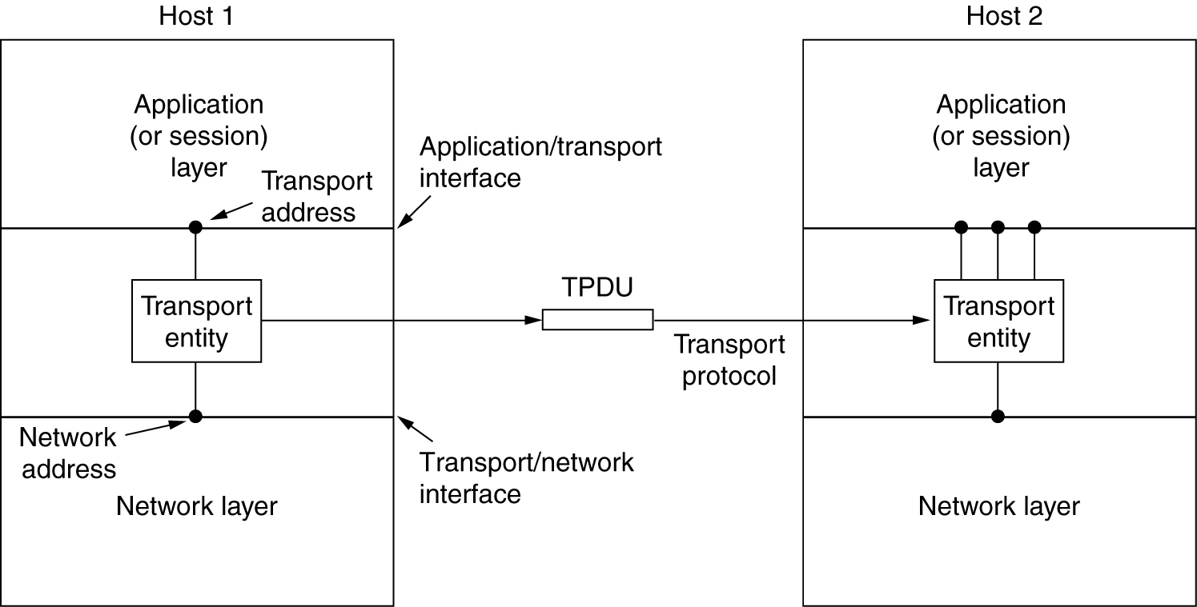
Services Provided to the Upper Layers
The network, transport, and application layers.

Slide 4
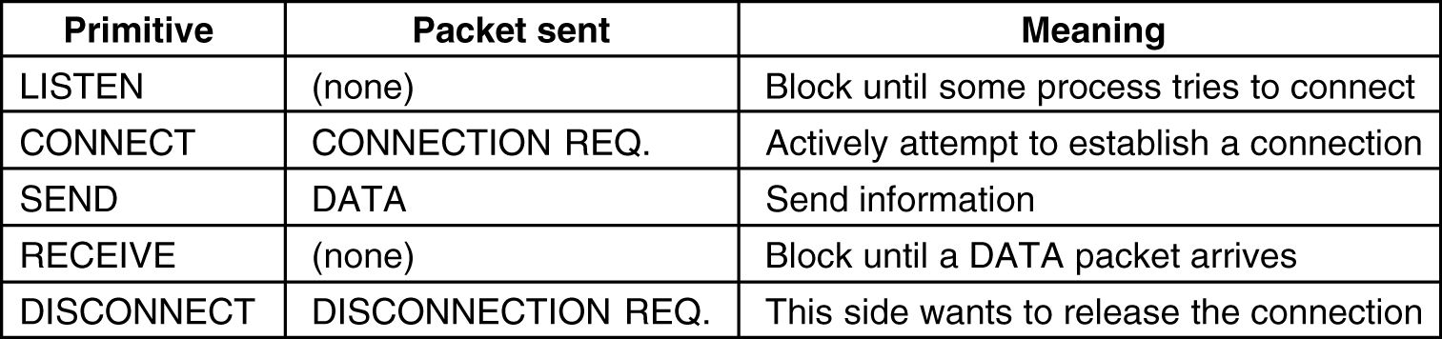
Transport Service Primitives
The primitives for a simple transport service.

Slide 5
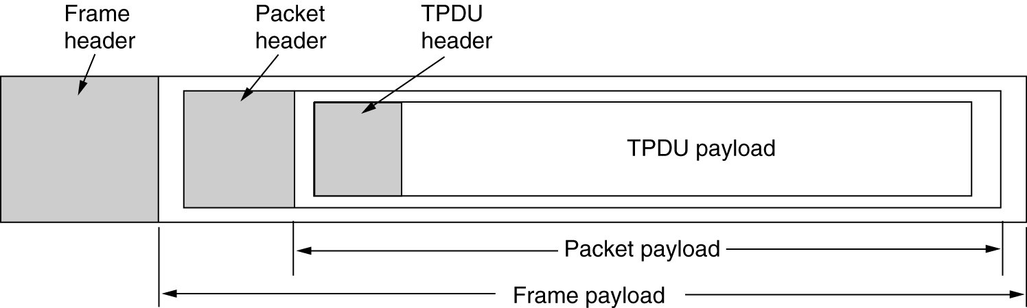
Transport Service Primitives (2)
The nesting of TPDUs, packets, and frames.

Slide 6
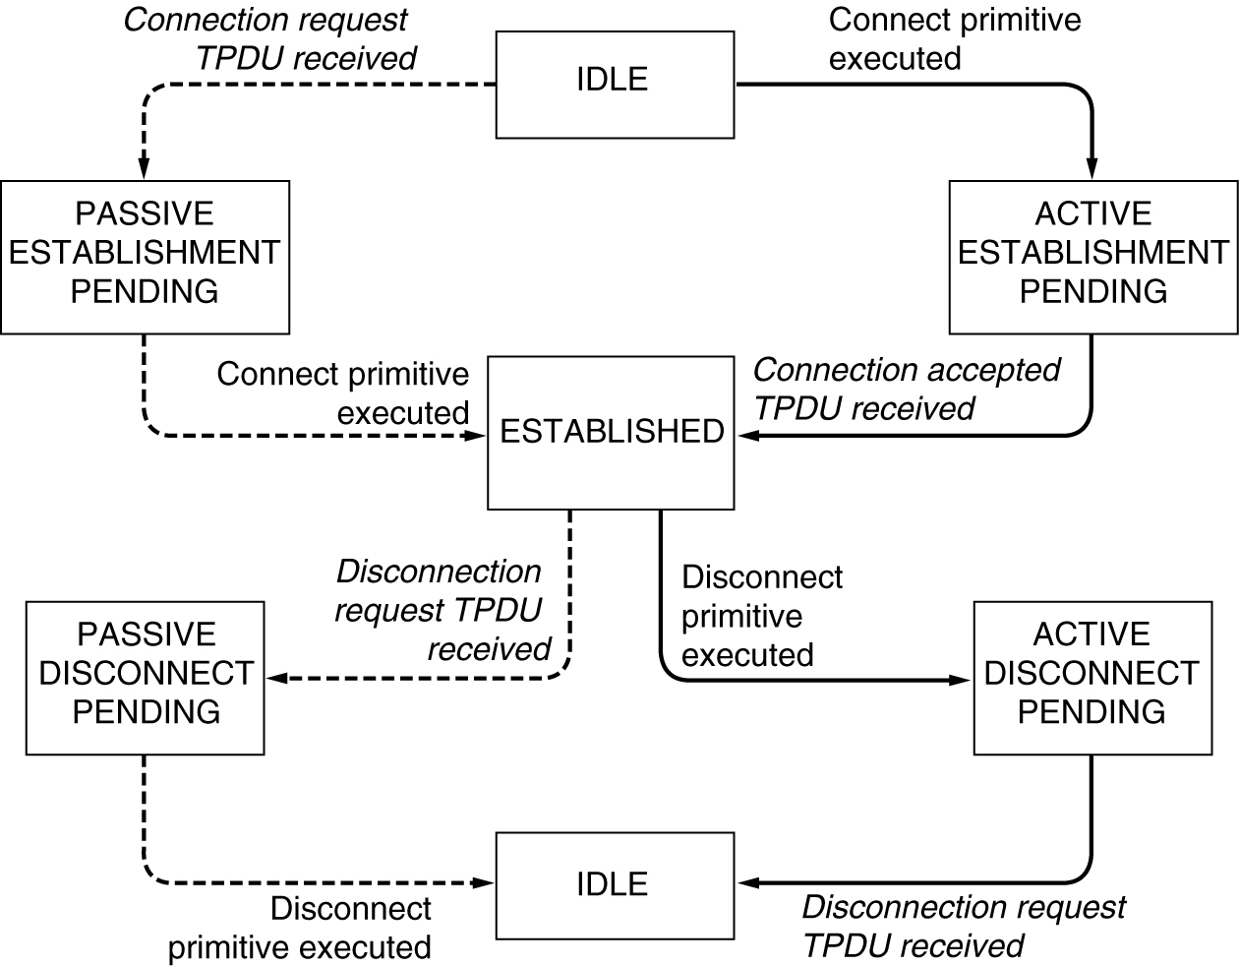
Transport Service Primitives (3)
A state diagram for a simple connection management scheme. Transitions labeled in italics are caused by packet arrivals. The solid lines show the client's state sequence. The dashed lines show the server's state sequence.

Slide 7
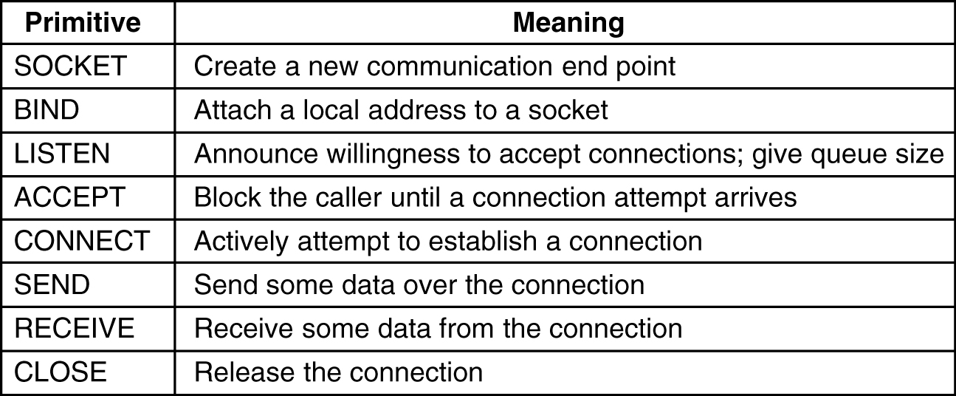
Berkeley Sockets
The socket primitives for TCP.

Slide 8
Elements of Transport Protocols
Addressing
Connection Establishment
Connection Release

Slide 9
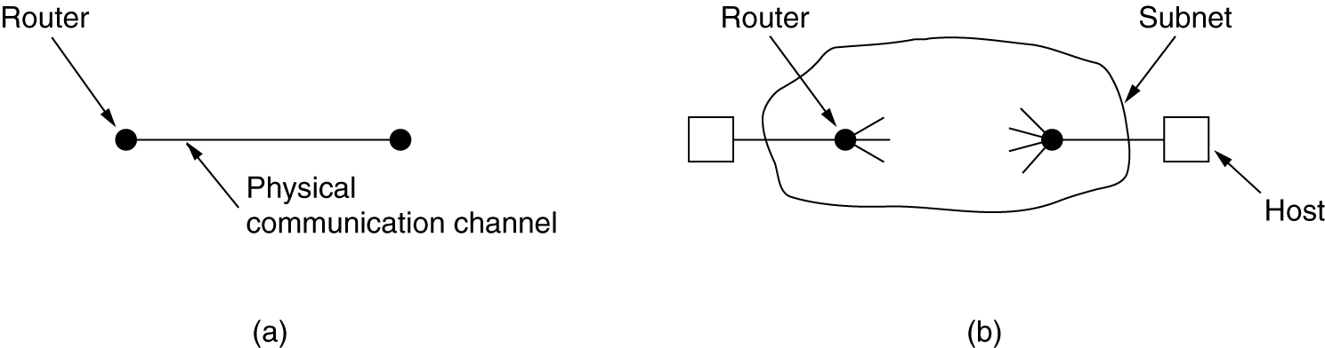
Transport Protocol
(a) Environment of the data link layer.
(b) Environment of the transport layer.

Slide 10
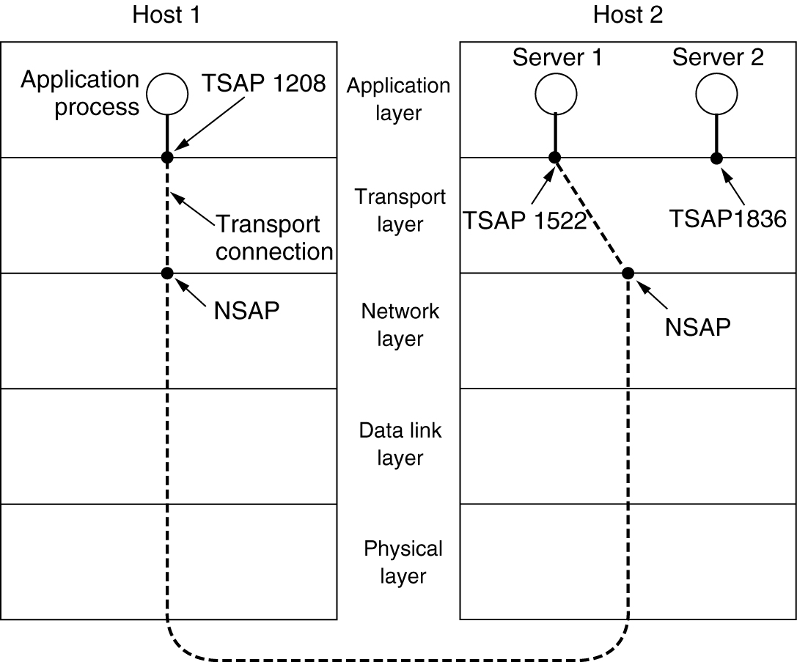
Addressing
TSAPs, NSAPs and transport connections.

Slide 11
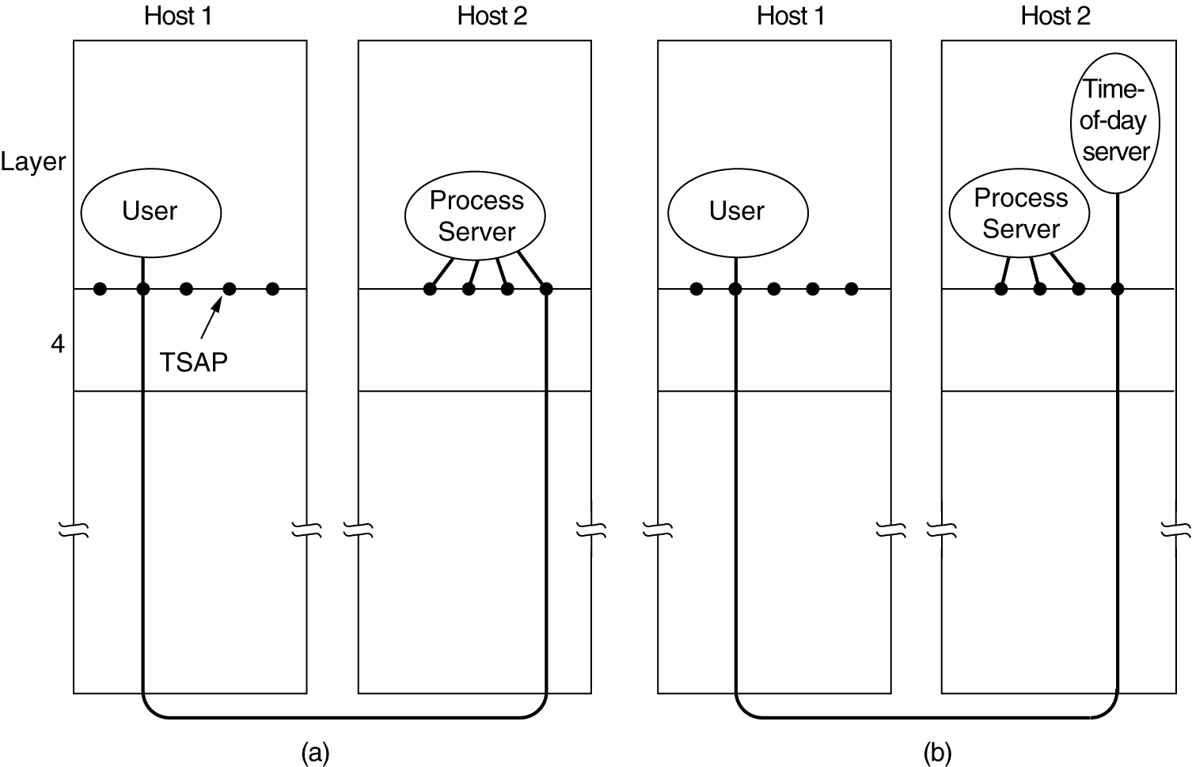
Connection Establishment
How a user process in host 1 establishes a connection with a time-of-day server in host 2.

Slide 12
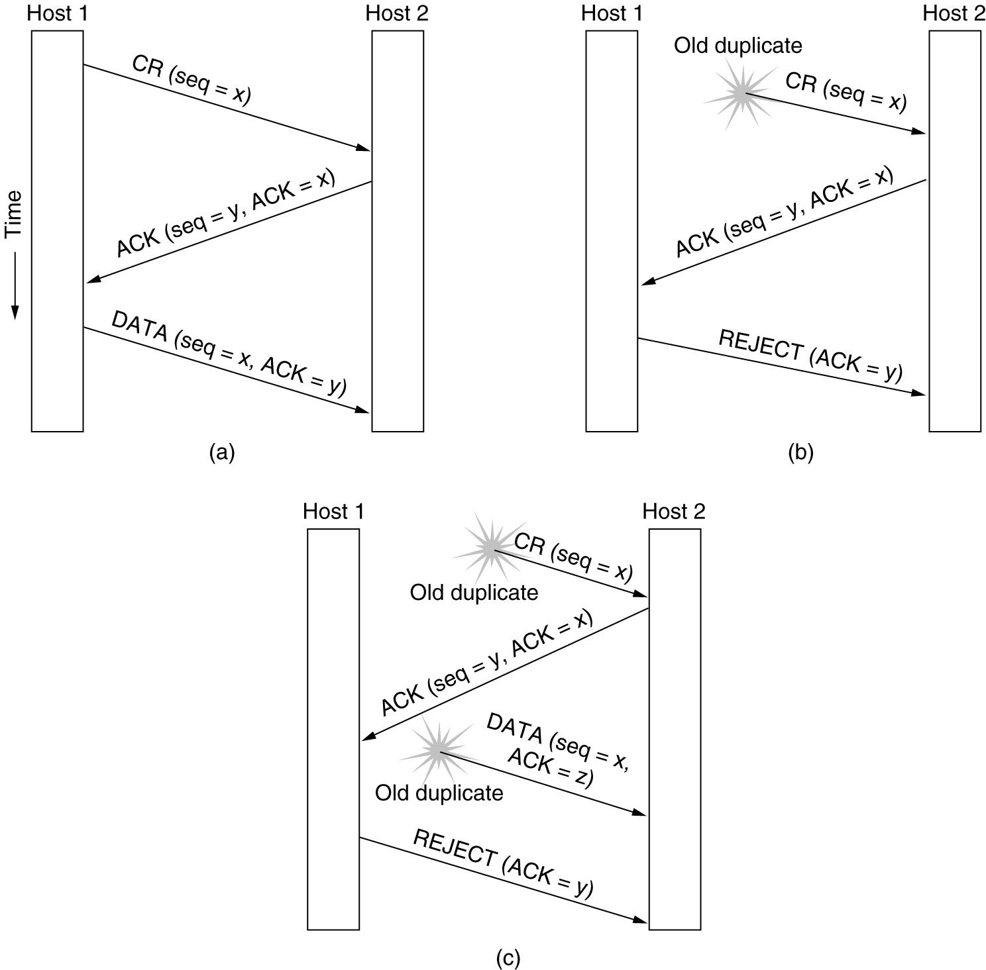
Connection Establishment (3)
Three protocol scenarios for establishing a connection using a three-way handshake. CR denotes CONNECTION REQUEST. (a) Normal operation, (b) Old CONNECTION REQUEST appearing out of nowhere. (c) Duplicate CONNECTION REQUEST and duplicate ACK.

Slide 13
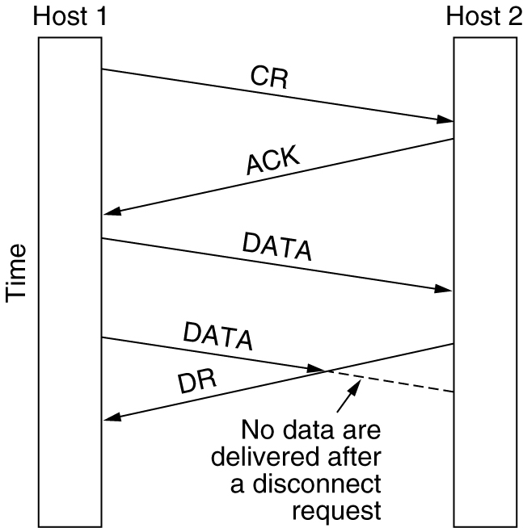
Connection Release
Abrupt disconnection with loss of data.

Slide 14
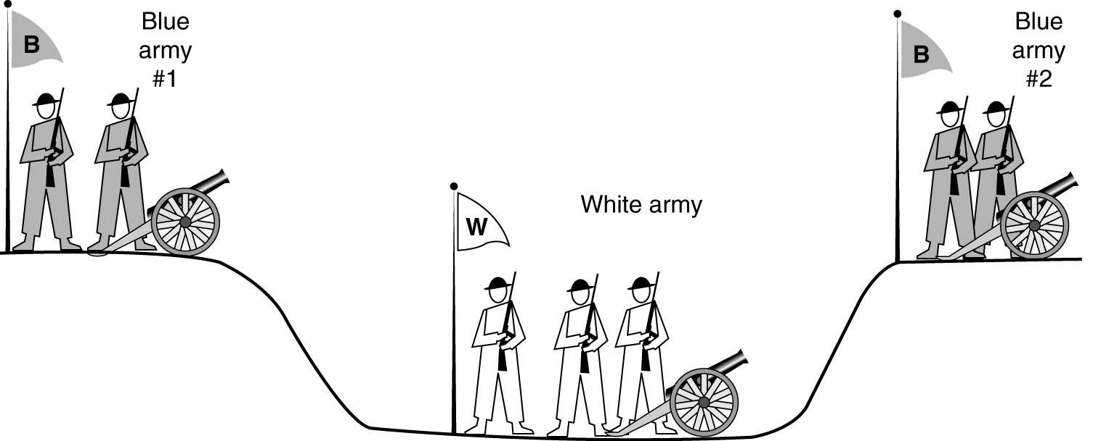
Connection Release (2)
The two-army problem.

Slide 15
To avoid two army problem, timers are used. If response to FIN is not forthcoming within two maximum packet lifetimes, the sender of the FIN releases the connection. The other side eventually notice that nobody seems to be listening to it any more and will time out as well.

Slide 16
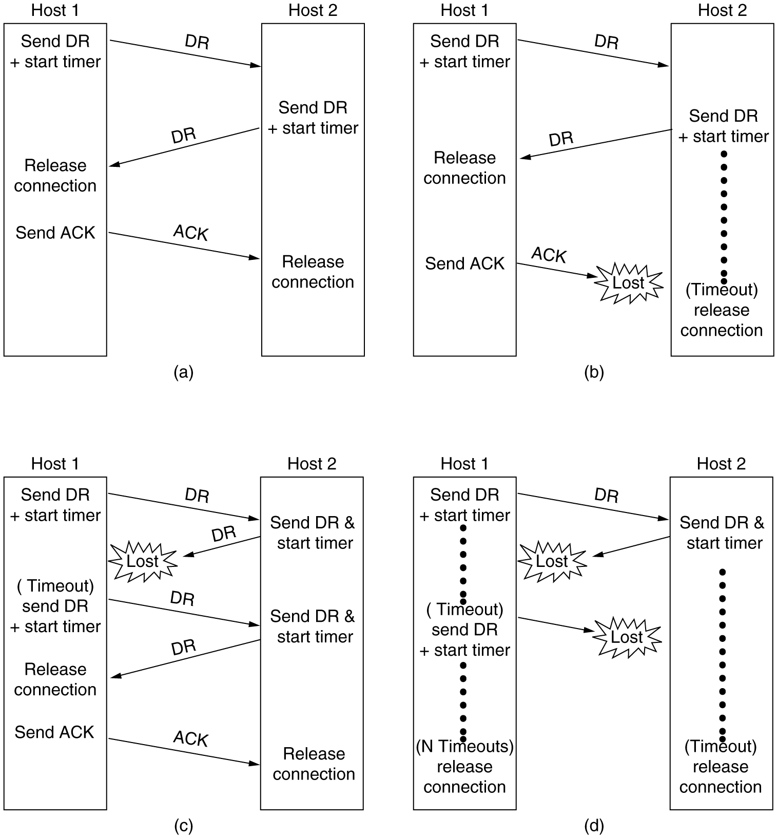
Connection Release (3)
6-14, a, b
Four protocol scenarios for releasing a connection. (a) Normal case of a three-way handshake. (b) final ACK lost.

Slide 17
Connection Release (4)
6-14, c,d
(c) Response lost. (d) Response lost and subsequent DRs lost.

Slide 18
The Internet Transport Protocols: UDP User Datagram Protocol
UDP is an unreliable and connectionless protocol. So, there is no need to establish a connection prior to data transfer.
The UDP enables process to process communication.

Slide 19
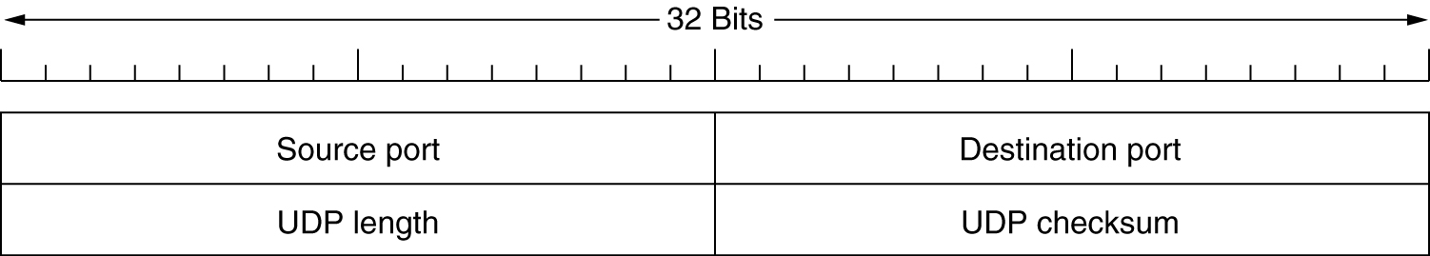
Introduction to UDP
The UDP header.

Slide 20
Source Port: Source Port is a 2 Byte long field used to identify the port number of the source. Destination Port: It is a 2 Byte long field, used to identify the port of the destined packet. Length: Length is the length of UDP including the header and the data. It is a 16-bits field. Checksum: Checksum is 2 Bytes long field. It is the 16-bit one’s complement of the one’s complement sum of the UDP header, the pseudo-header of information from the IP header, and the data, padded with zero octets at the end (if necessary) to make a multiple of two octets.

Slide 21
Applications Used for simple request-response communication when the size of data is less and hence there is lesser concern about flow and error control. It is a suitable protocol for multicasting as UDP supports packet switching. UDP is widely used in online gaming Streaming media applications VoIP (Voice over Internet Protocol) services, such as Skype and WhatsApp, use UDP for real-time voice communication. DNS (Domain Name System) also uses UDP for its query/response messages.

Slide 22
The Internet Transport Protocols: TCP
Introduction to TCP
The TCP Service Model
The TCP Protocol
The TCP Segment Header
TCP Connection Establishment
TCP Connection Release

Slide 23
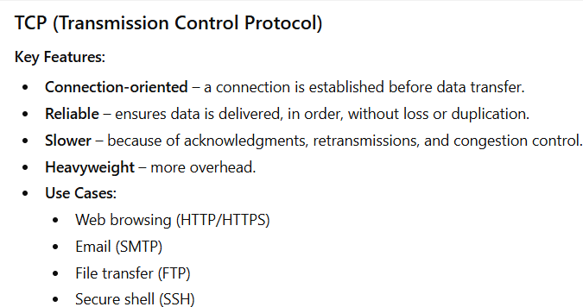

Slide 24
The TCP Service Model
Port
Protocol
Use
21
FTP
File transfer
23
Telnet
Remote login
25
SMTP
E-mail
69
TFTP
Trivial File Transfer Protocol
79
Finger
Lookup info about a user
80
HTTP
World Wide Web
110
POP-3
Remote e-mail access
119
NNTP
USENET news
Some assigned ports.

Slide 25
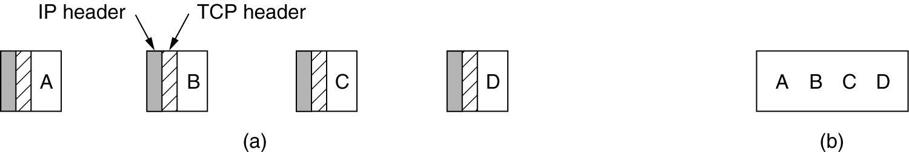
The TCP Service Model (2)
(a) Four 512-byte segments sent as separate IP datagrams.
(b) The 2048 bytes of data delivered to the application in a single READ CALL.

Slide 26
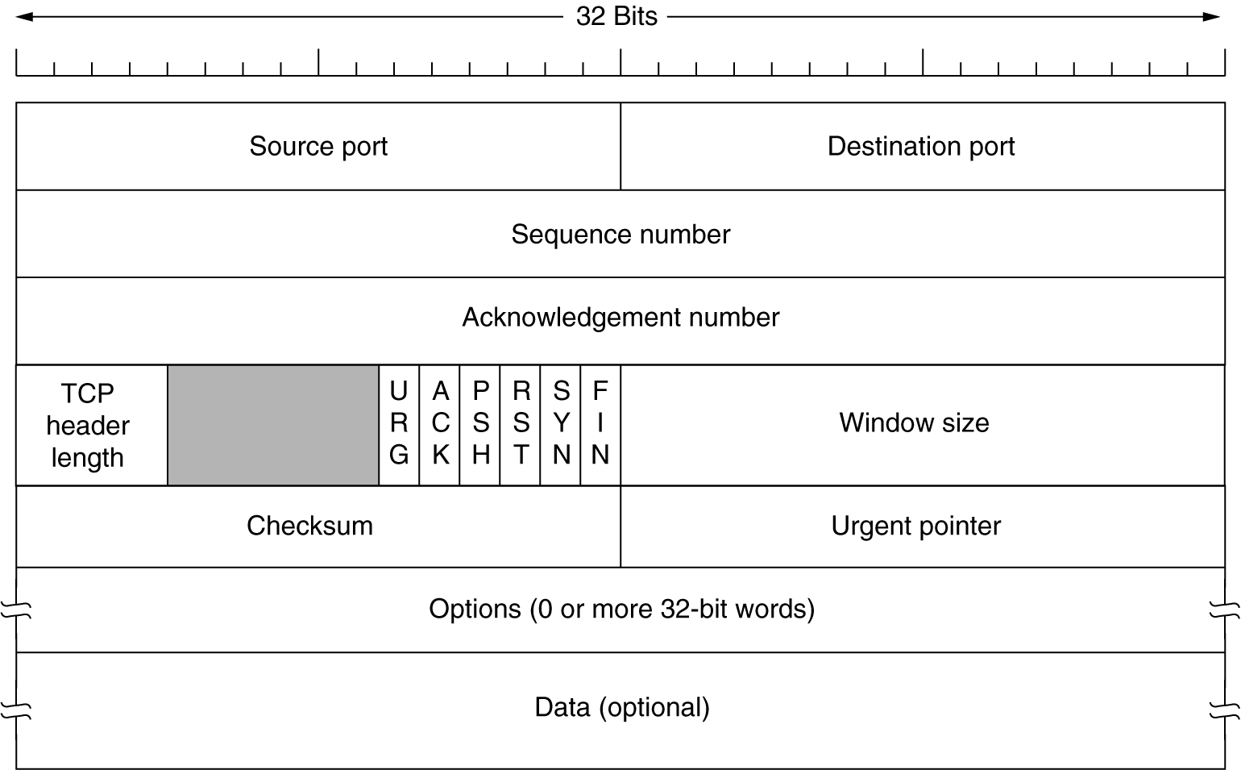
The TCP Segment Header
TCP Header.

Slide 27
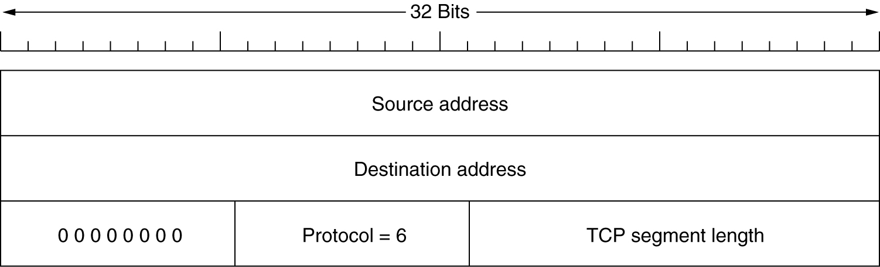
The TCP Segment Header (2)
The pseudoheader included in the TCP checksum.

Slide 28
The TCP Segment Header
Every TCP segment consists of a 20 byte fixed format header. Header options may follow the fixed header. With a header so that it can tag up to 65535 data bytes.
Source Port
It is a 16-bit source port number used by the receiver to reply.
Destination Port
It is a 16-bit destination port number.
Sequence Number
The sequence number of the first data byte in this segment. During the SYN Control bit is set, and the sequence number is n, and the first data byte is n + 1.
Acknowledgement Number
If the ACK control bit is set, this field contains the next number that the receiver expects to receive.
Data Offset
The several 32-bit words in the TCP header shows from where the user data begins.
Reserved (6 bit)
It is reserved for future use.

Slide 29
URG
It indicates an urgent pointer field that data type is urgent or not.
ACK
It indicates that the acknowledgement field in a segment is significant, as discussed early.
PUSH
The PUSH flag is set or reset according to a data type that is sent immediately or not.
RST It Resets the connection.
SYN
It synchronizes the sequence number.
FIN
This indicates no more data from the sender.

Slide 30
Window
It is used in Acknowledgement segment. It specifies the number of data bytes, beginning with the one indicated in the acknowledgement number field that the receiver is ready to accept.
Checksum
It is used for error detection.
Options
The IP datagram options provide additional punctuality. It can use several optional parameters between a TCP sender and receiver. It depends on the options used. The length of the field may vary in size, but it can't be larger than 40 bytes due to the header field's size, which is 4 bit.
The most typical option is the maximum segment size MASS option. A TCP receiver communicates to the TCP sender the total length of the segment it can accept with this option.

Slide 31
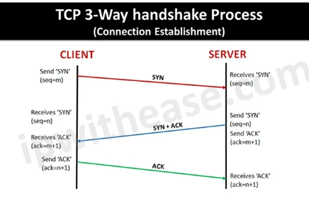

Slide 32
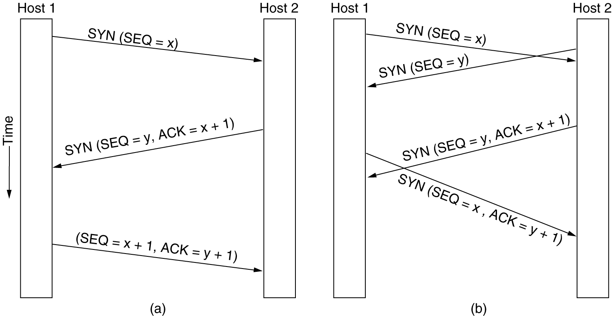
TCP Connection Establishment
6-31
(a) TCP connection establishment in the normal case.
(b) Call collision.

Slide 33
TCP Connection Release
Although TCP connections are full duplex, to understand connection release it is best to think them as a pair of simplex connections.
To release a connection, either party can send a TCP segment with the FIN bit set, which means that it has no more data to transmit.
When FIN bit is acknowledged, that direction is shut down for new data. Data may continue to flow indefinitely in the other direction, however.
When both directions have been shut down, the connection is released.
Normally four TCP segments are needed, but it is possible for first ACK and second FIN to be contained in same segment, reducing the total count to three.

Slide 35
The Application Layer

Slide 36
DNS – The Domain Name System
The DNS Name Space
Resource Records
Name Servers

Slide 37
DNS
DNS is the invention of a hierarchical, domain-based naming scheme and a distributed database system for implementing this naming scheme.
DNS is used to map a name onto an IP address, an application program calls a library procedure called the Resolver, passing it the name as a parameter.
The Resolver sends a UDP packet to a local DNS server, which then looks up the name and returns IP address, the program can then establish a TCP connection with the destination or send it UDP packets.

Slide 38
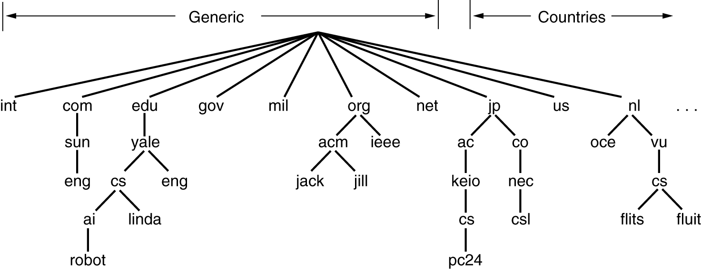
The DNS Name Space
A portion of the Internet domain name space.

Slide 39
DNS Name Space
Internet is divided into 200 top-level domains, where each domain covers many hosts.
Each domain is partitioned into subdomains, and these are further partitioned, and so on.
Top-level domains : Generic
Countries.
Generic Domains were com(commercial), edu(educational institutions), gov, int(international organizations), mil, net(network providers), and org(non profit organization).
The Country domains include one entry for every country.
Each domain is named by the path upward from it the (unnamed) root.

Slide 40
DNS(contd..)
Domain names can be either absolute or relative.
An absolute domain name always ends with a period (e.g.,eng.sun.com)
Relative does not.
Domain names are case insensitive.
Domains can be inserted into the tree in two different ways.
Each domain controls how it allocates the domains under it.
To create a new domain, permission is required of the domain in which it will be included. So that name conflicts are avoided.
Once domain has been created & registered, it can create subdomains, without getting permission from anybody higher up the tree.

Slide 41
Resource Records
Every Domain, whether it is a single host or a top-level domain, can have a set of resource records associated with it.
For single host, the most common resource record is just its IP address, but many other kinds of resource records also exist.
When a resolver gives a domain name to DNS, it gets back resource records associated with that name. Thus, the primary function of DNS is to map domain names onto resource records.
A resource record is a five-tuple. The format is as follows:
Domain_name Time_to_live Class Type Value
Domain_name :tells the domain to which this record applies
Time_to_live field gives an indication of how stable the record is.
Class: For Internet information, it is always IN
For non-Internet information, other codes can be used.

Slide 42
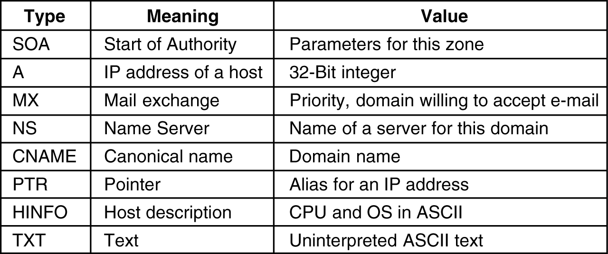
Resource Records Type: This field tells what kind of record this is. The important types are listed below
The principal DNS resource records types.
Value: This can be a number, a domain name, or an ASCII string.

Slide 43
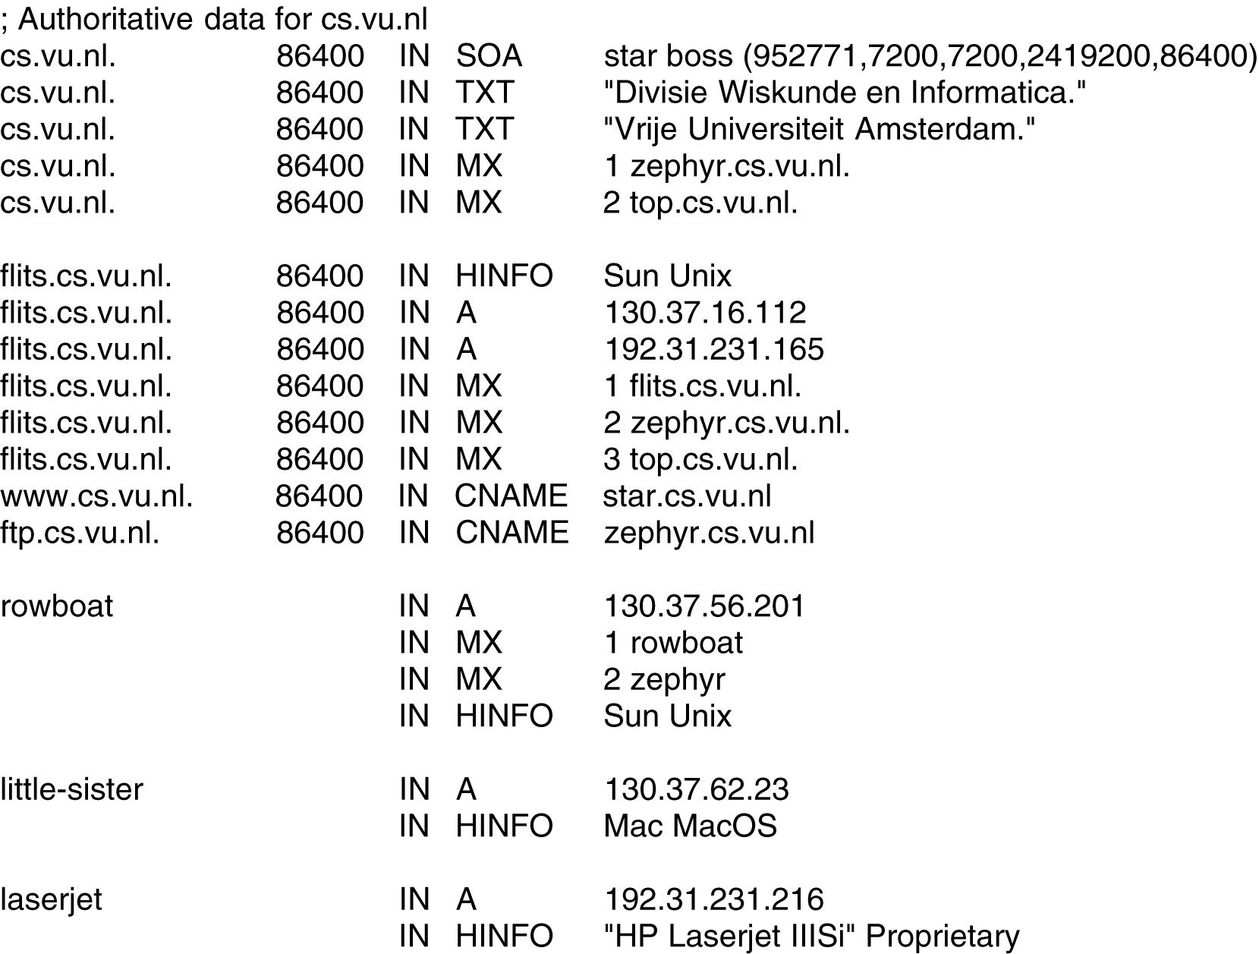
Resource Records (2)
A portion of a possible DNS database for cs.vu.nl.

Slide 44
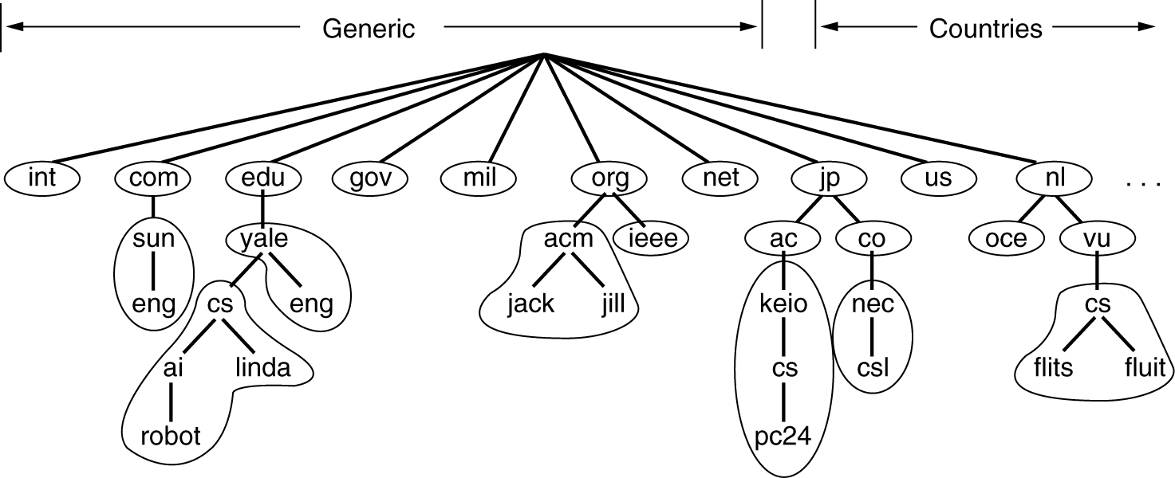
Name Servers
Part of the DNS name space showing the division into zones.

Slide 45
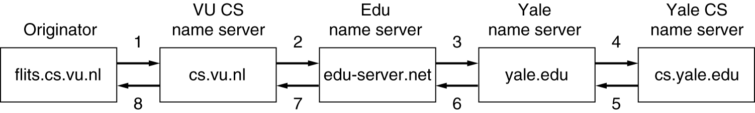
Name Servers (2)
How a resolver looks up a remote name in eight steps.

Slide 46
The World Wide Web
Architectural Overview
Static Web Documents
Dynamic Web Documents
HTTP – The HyperText Transfer Protocol
Performance Ehnancements
The Wireless Web

Slide 47
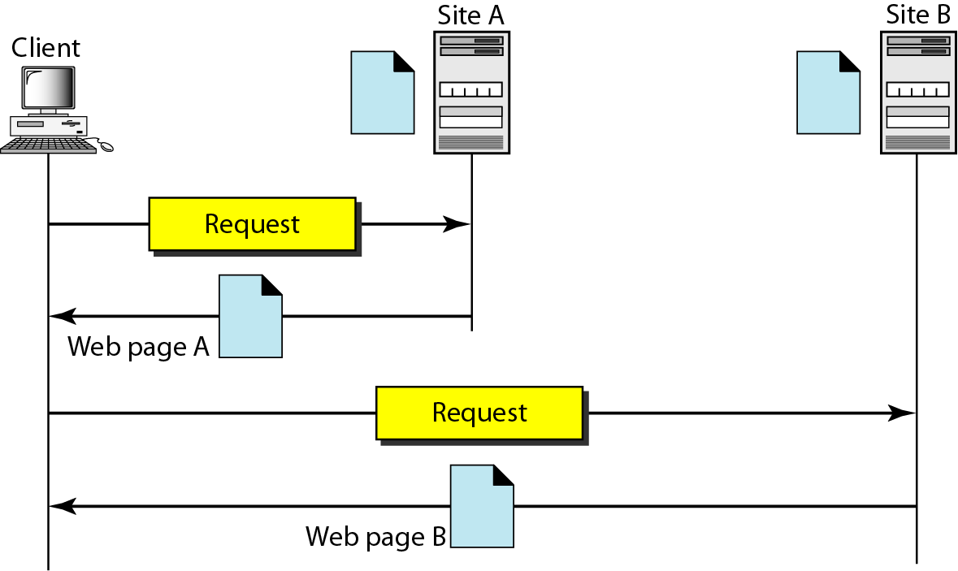
Architecture of WWW
The WWW today is a distributed client/server service, in which a client using a browser can access a service using a server. However, the service provided is distributed over many locations called sites.

Slide 48
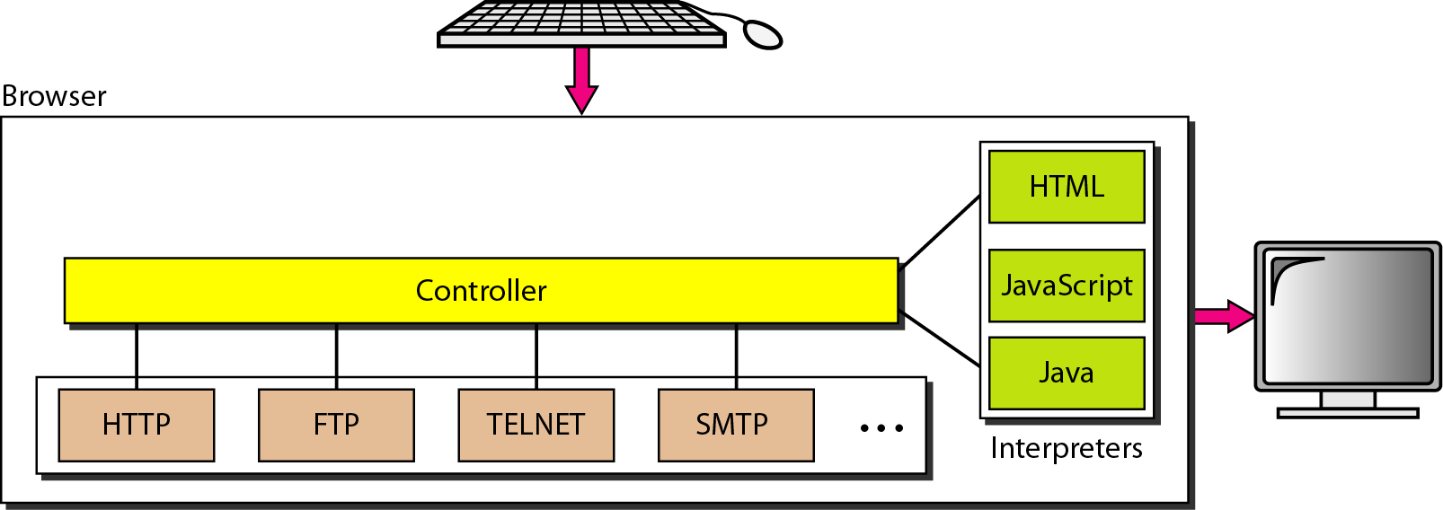
Browser and URL
Uniform Resource Locator
Cookies ??

Slide 49
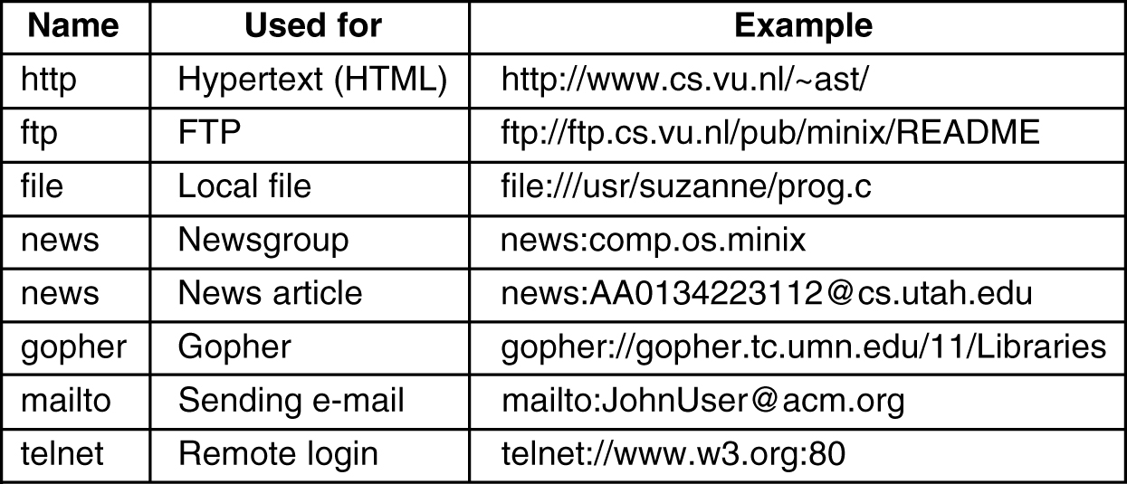
URLs – Uniform Resource Locaters
Some common URLs.

Slide 50
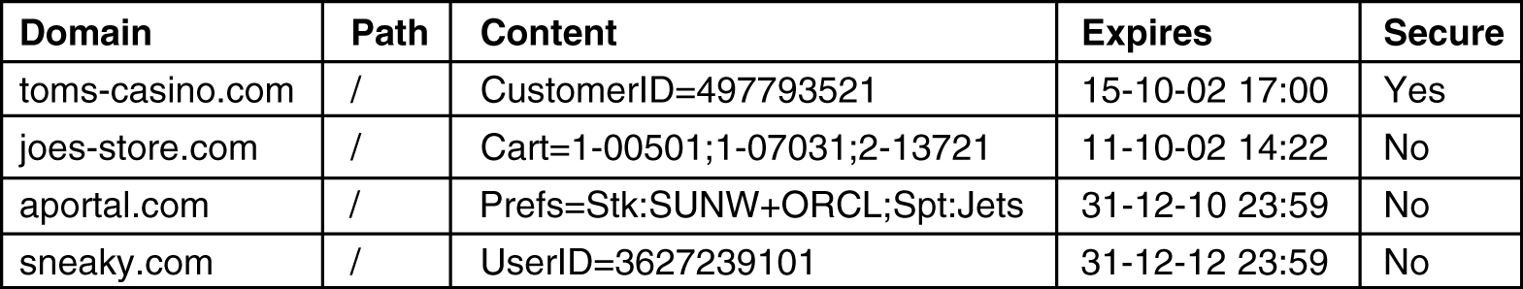
Statelessness and Cookies
Some examples of cookies.

Slide 51
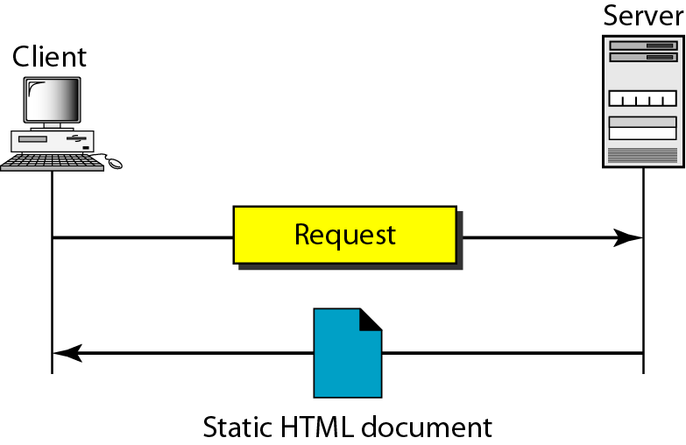
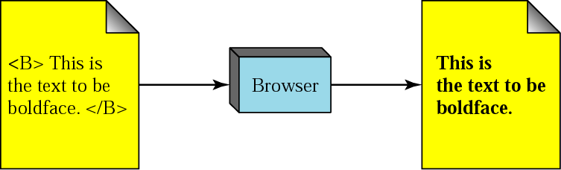
Static Documents: HTML

Slide 52
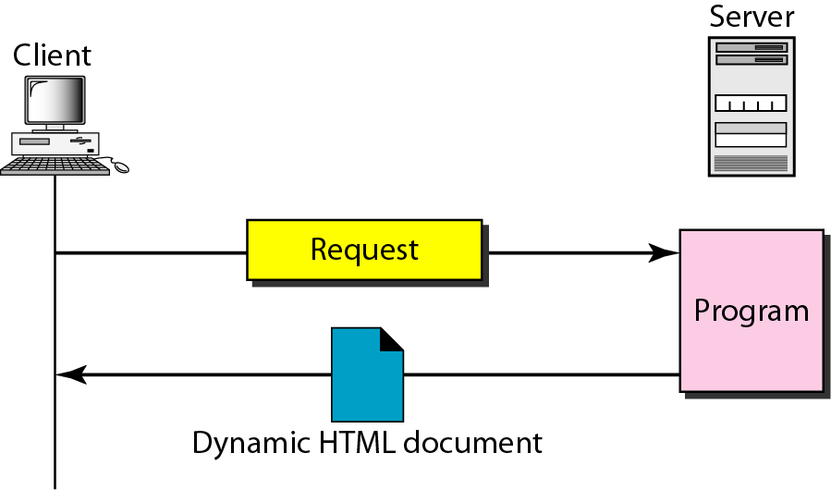
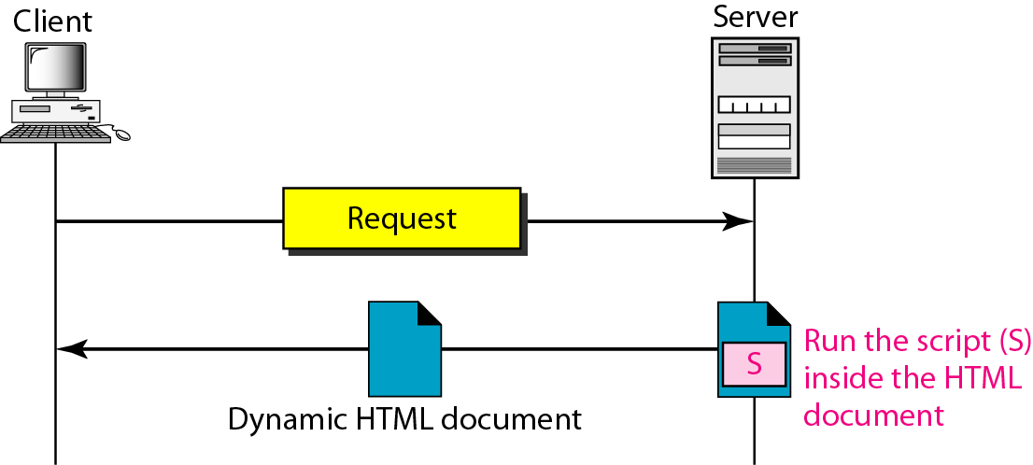
Dynamic Documents: CGI and Scripting
Common Gateway Interface
Server-site Script

Slide 53
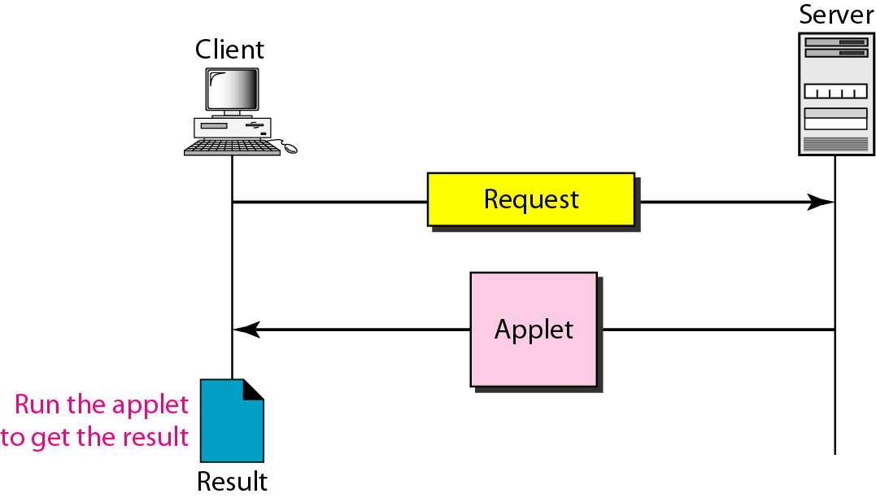
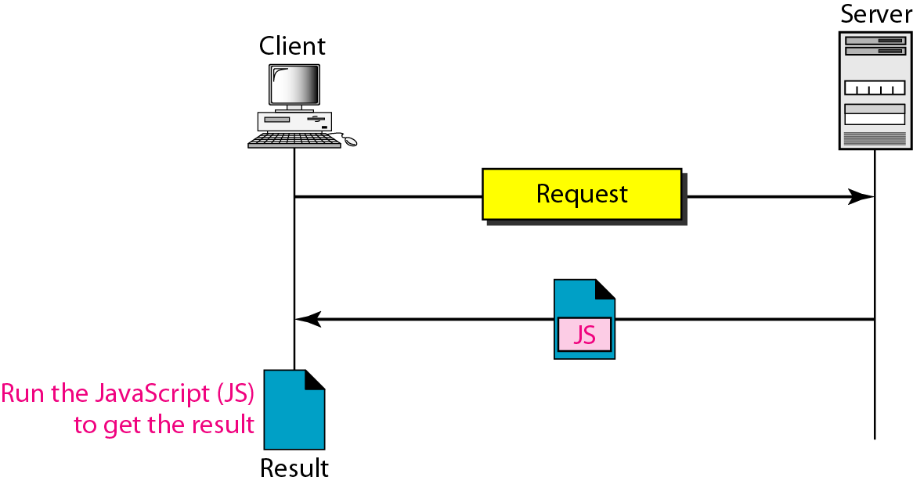
Active Documents: Java Applets and JavaScript
Active document using Java applet
Active document using client-site script
Computer Networks
27-53

Slide 54
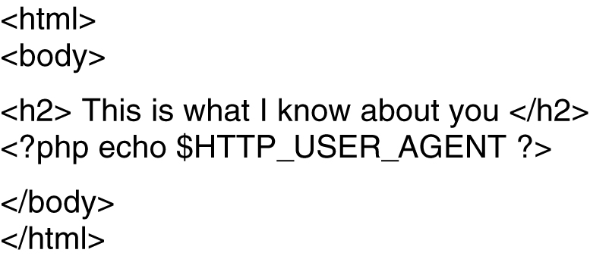
Dynamic Web Documents (2)
A sample HTML page with embedded PHP.

Slide 55
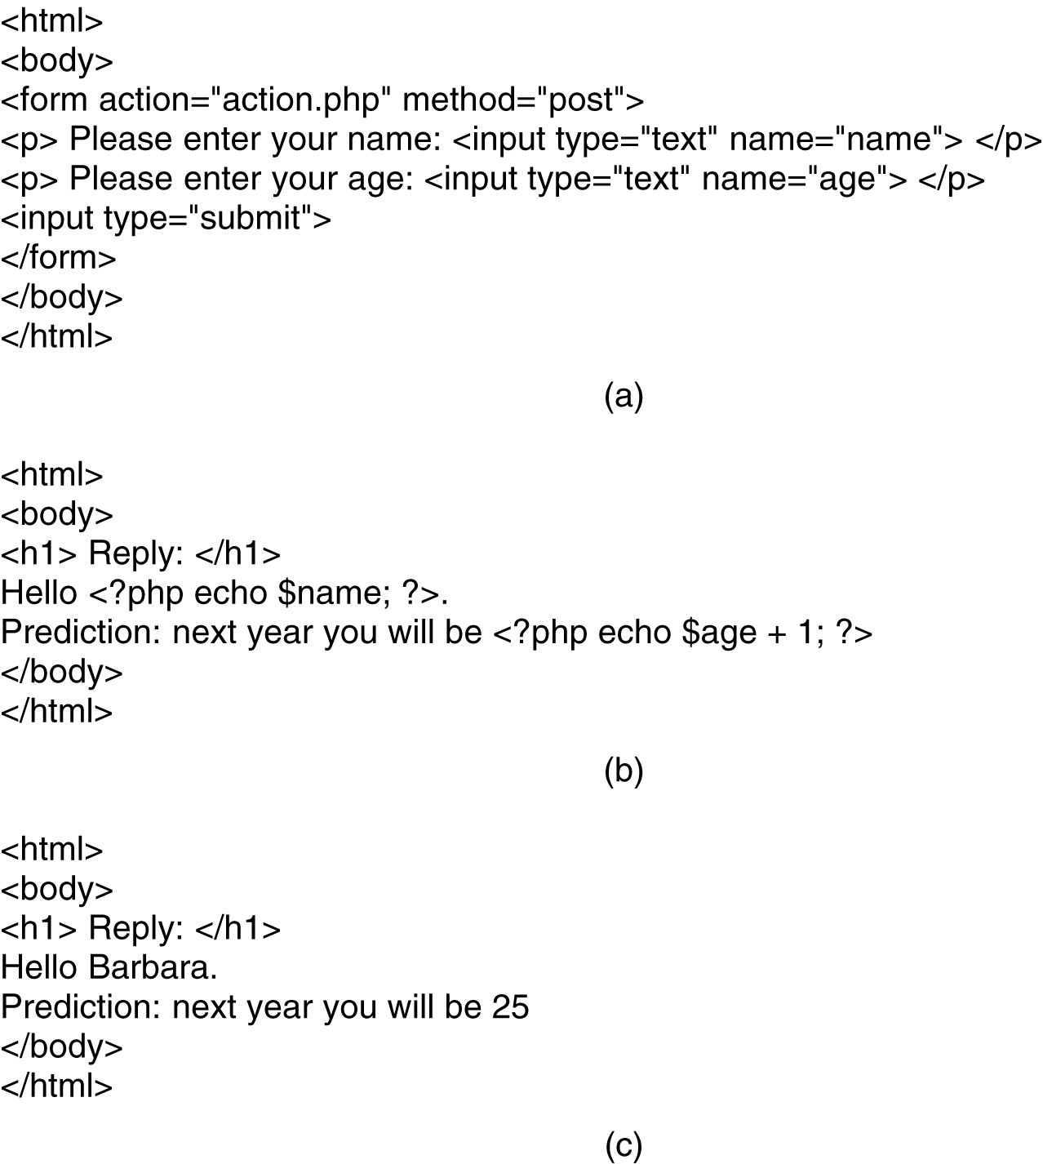
Dynamic Web Documents (3)
(a) A Web page containing a form. (b) A PHP script for handling the output of the form. (c) Output from the PHP script when the inputs are "Barbara" and 24 respectively.

Slide 56
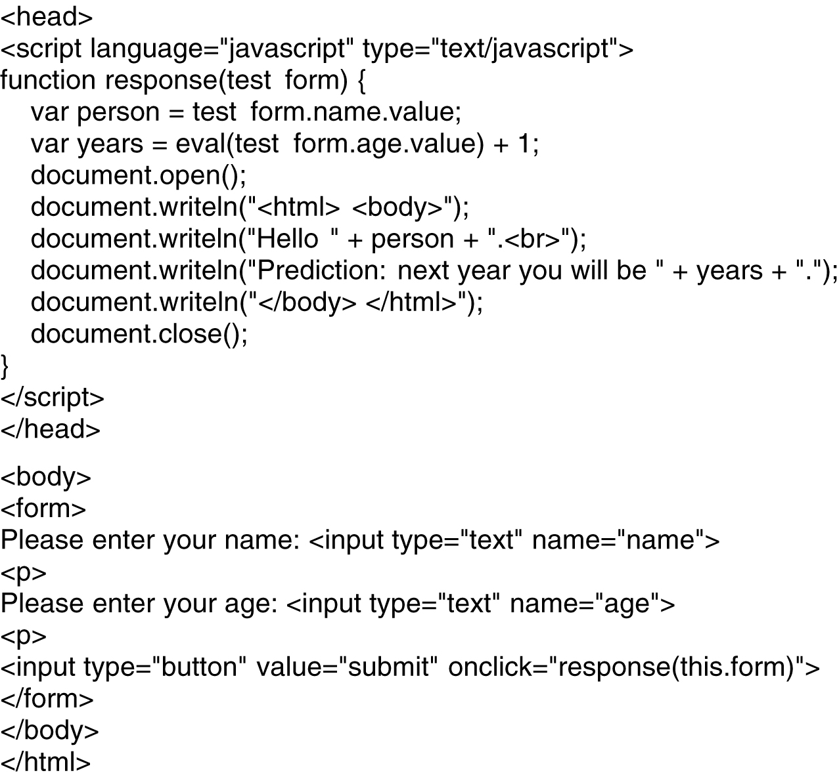
Client-Side Dynamic Web Page Generation
Use of JavaScript for processing a form.

Slide 57
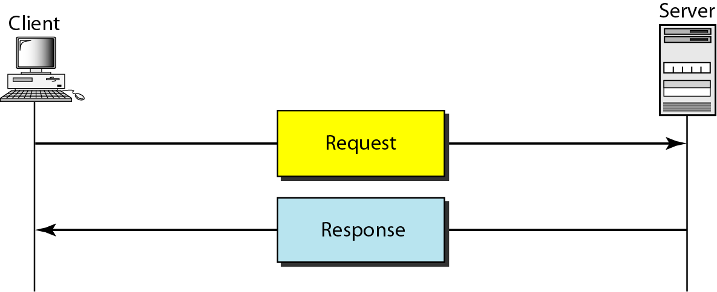
Hypertext Transfer Protocol (HTTP)
HTTP is used mainly to access data on the WWW
HTTP uses the services of TCP on well-known port 80

Slide 58
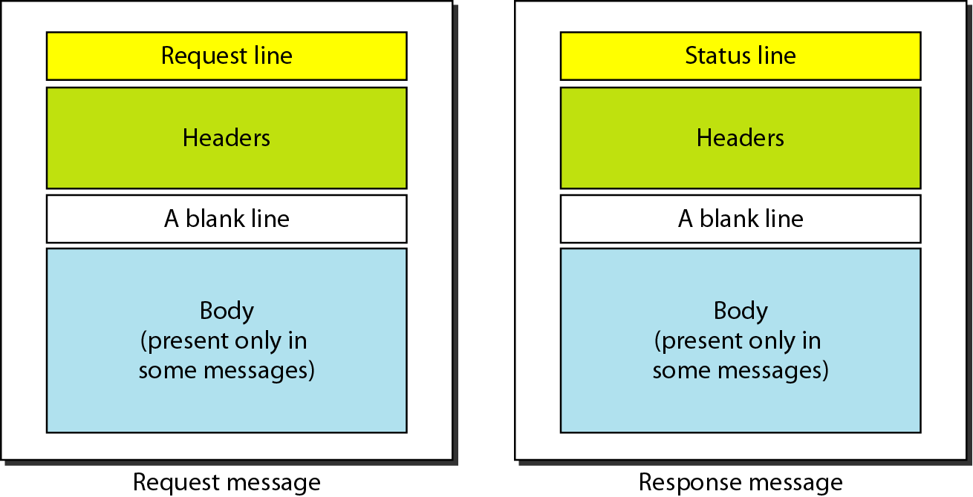
Request and Response Message

Slide 59
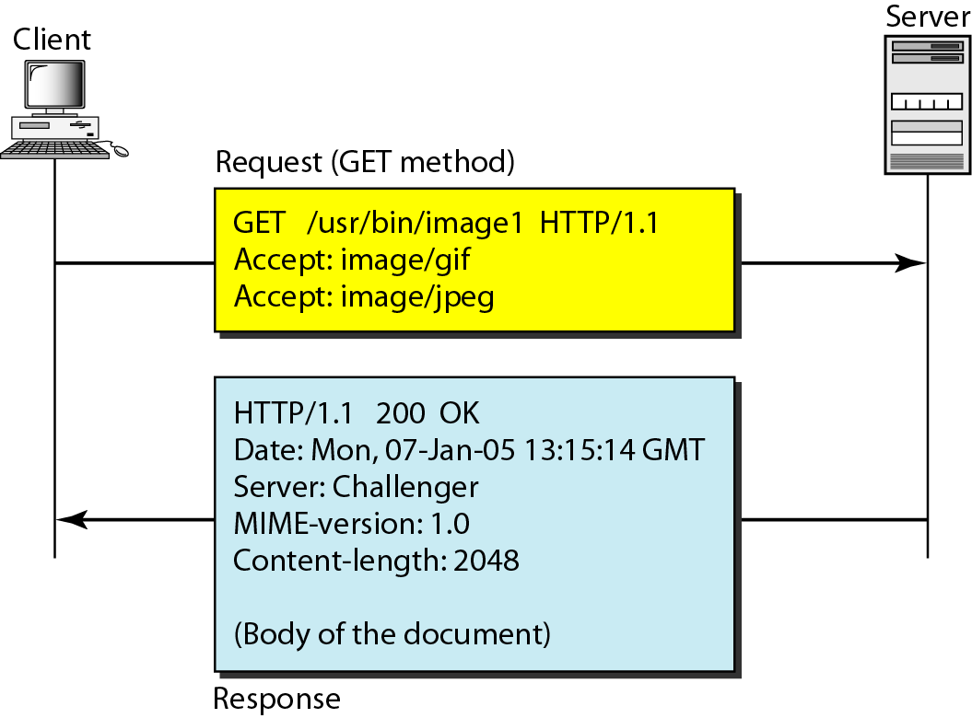
Example 1

Slide 60
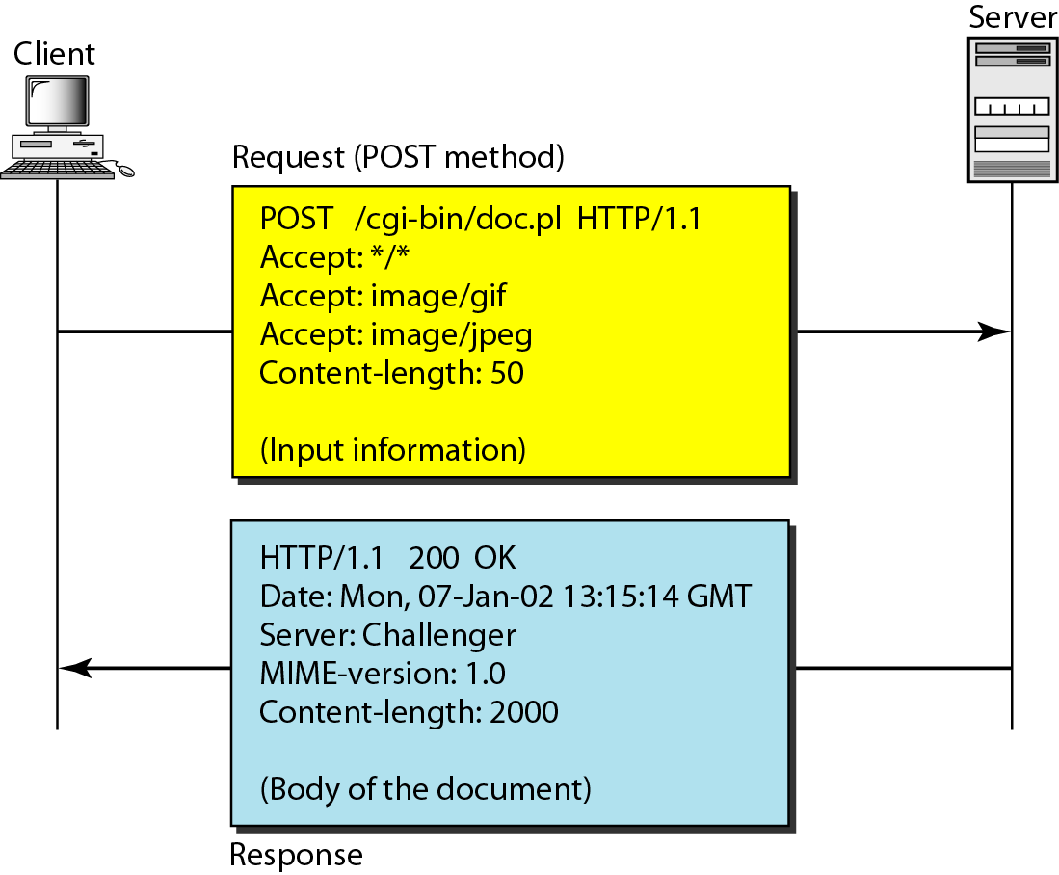
Example 2

Slide 61
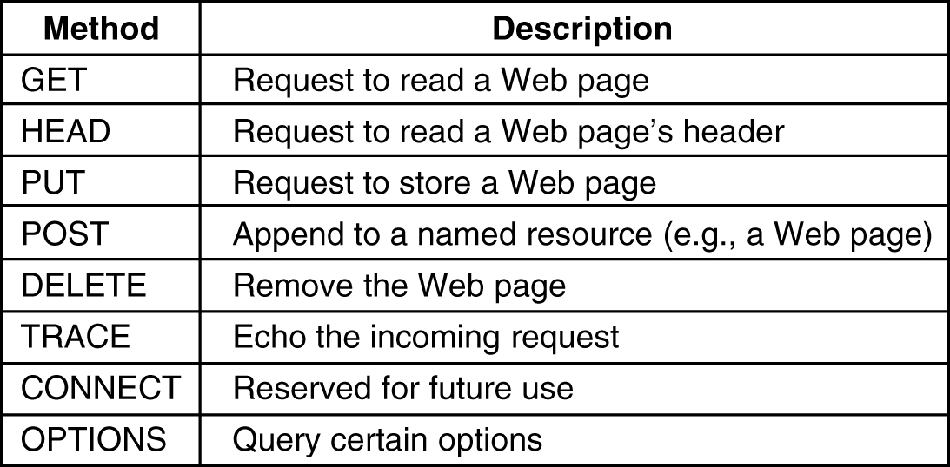
HTTP Methods
The built-in HTTP request methods.

Slide 62
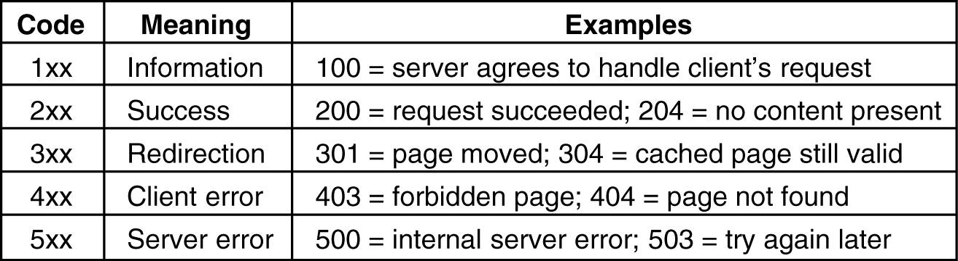
HTTP Methods (2)
The status code response groups.

Slide 63
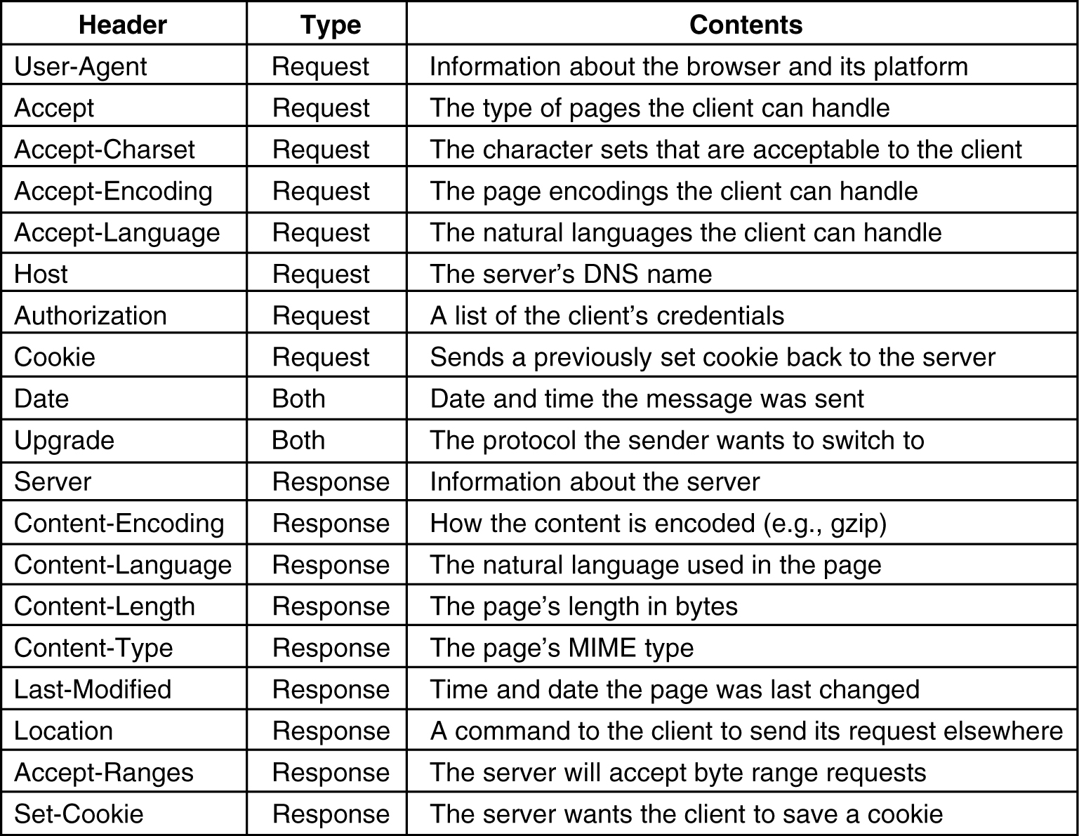
HTTP Message Headers
Some HTTP message headers.

Slide 64
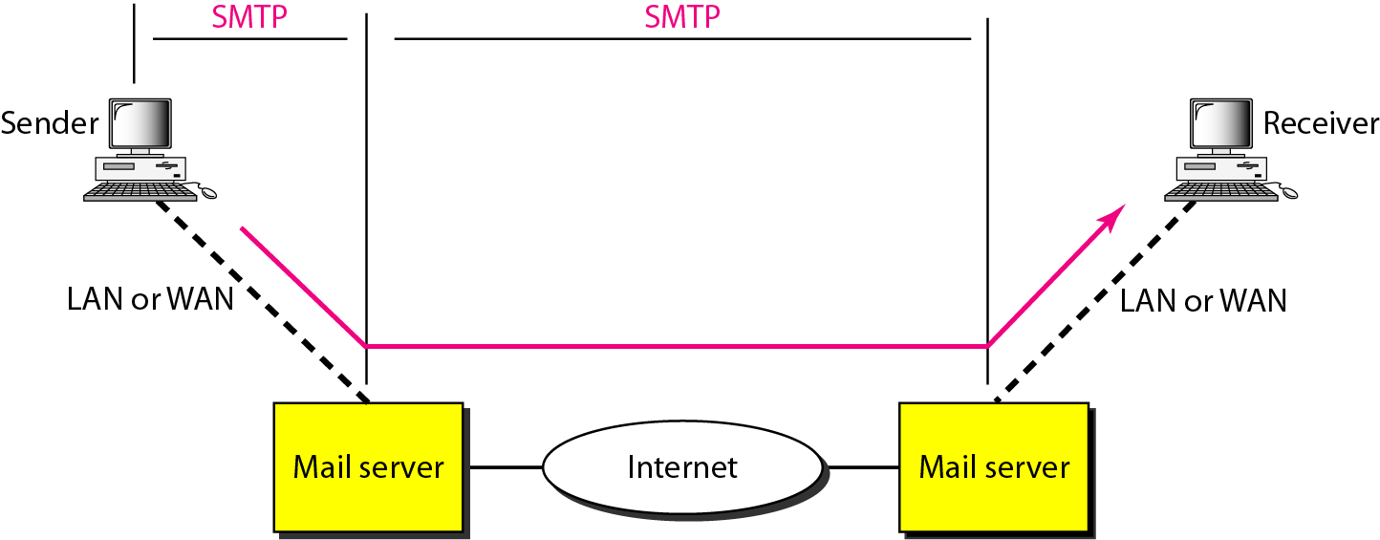
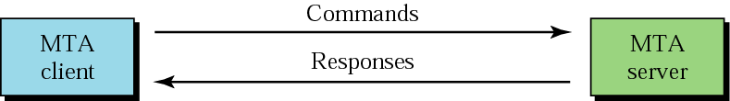
Mail Transfer Agent (MTA): SMTP
The actual mail transfer is done through MTA

Slide 65
Application Layer
These SMTP commands specify the sender’s and receiver’s e-mail address, along with the message to be send.
The exchange of commands between servers is carried out without intervention of any user.
In case, message cannot be delivered, an error report is sent to the sender which makes SMTP a reliable protocol.
SMTP Commands
S.No | Command | Description
1. | HELLO | This command initiates the SMTP conversation.
2. | EHELLO | This is an alternative command to initiate the conversation. ESMTP indicates that the sender server wants to use extended SMTP protocol.
3. | MAIL FROM | This indicates the sender’s address.

Slide 66
Application Layer
S.No | Command | Description
4. | RCPT TO | It identifies the recipient of the mail. In order to deliver similar message to multiple users this command can be repeated multiple times.
5. | SIZE | This command let the server know the size of attached message in bytes.
6. | DATA | The DATA command signifies that a stream of data will follow. Here stream of data refers to the body of the message.
7. | QUIT | This commands is used to terminate the SMTP connection.
8. | VERFY | This command is used by the receiving server in order to verify whether the given username is valid or not.
9 | EXPN | It is same as VRFY, except it will list all the users name when it used with a distribution list.

Slide 67
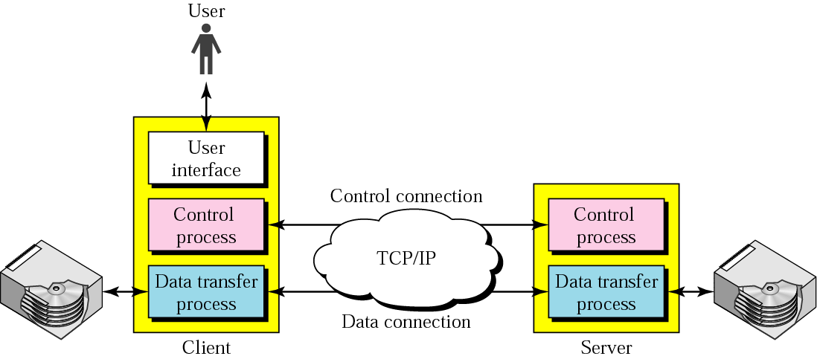
File Transfer
FTP uses the services of TCP. It needs two TCP connections. The well-known port 21 is used for the control connection, and the well-known port 20 is used for the data connection.

Slide 68
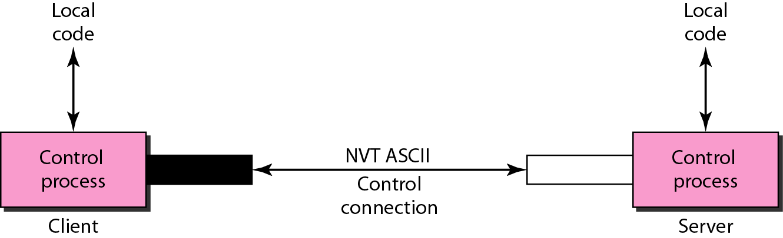
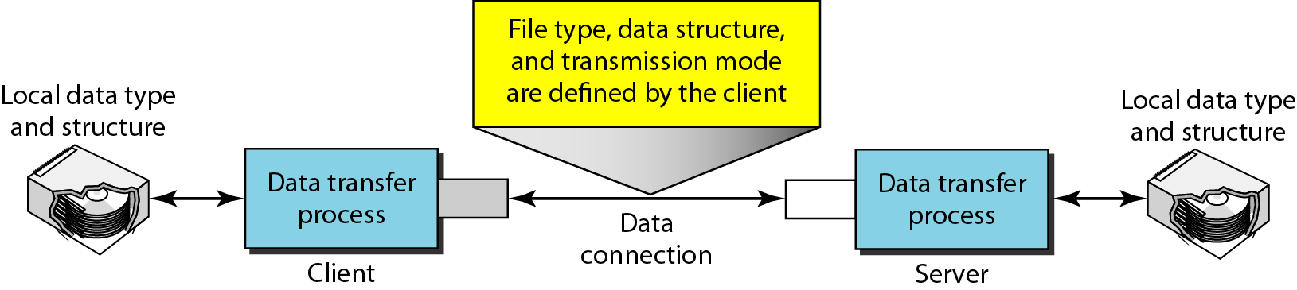
Communication over Two Connections

